Slide 1
Name Reservation & Company Incorporation
(Combined Process) with
FBR Integration

Slide 2
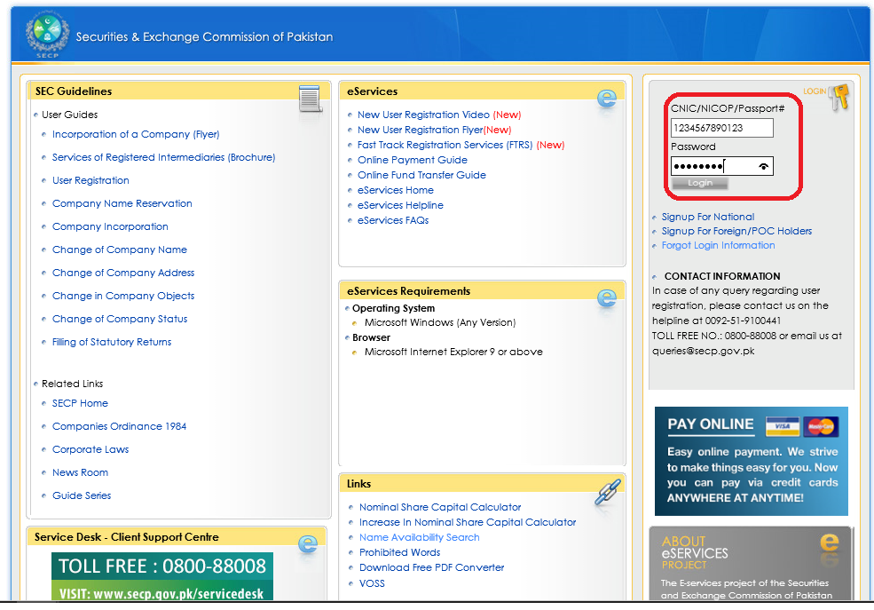
Login to User Account
Enter User ID and Password of the User and Login to his/her personal User Account.

Slide 3
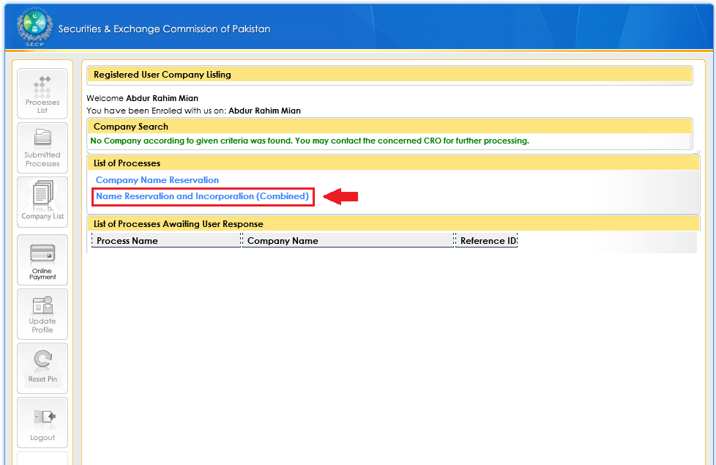
Opt for Combined Process
(Name Reservation and Incorporation)
Click “Name Reservation and Incorporation (Combined)” to start combined application.

Slide 4
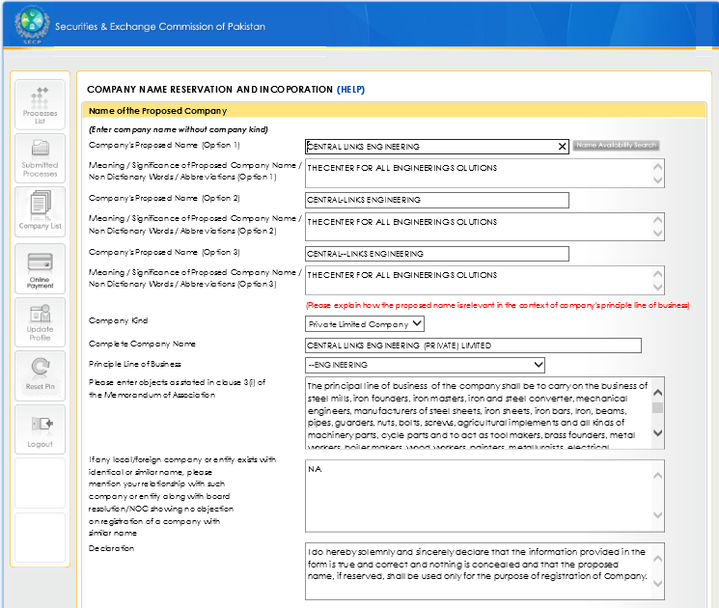
Application: Company Name Reservation Details
Enter data required for Company Name Reservation.

Slide 5
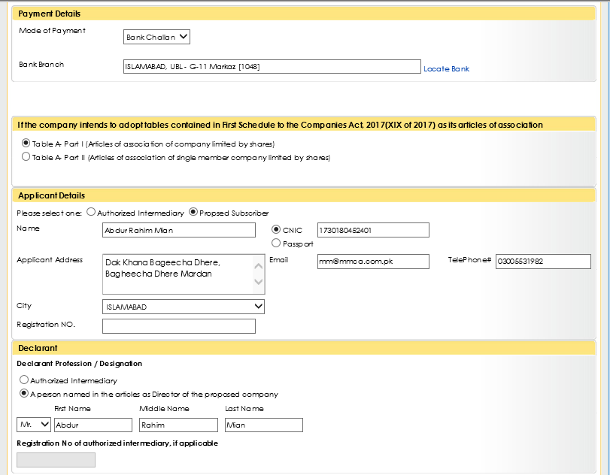
Application: Payment, Applicant, and Declarant Details
(Continued)
Enter the required data.

Slide 6
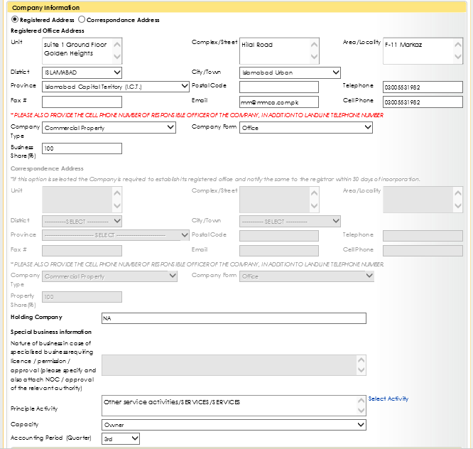
Application: Company Information
(Continued)
Enter the required Company Information.

Slide 7
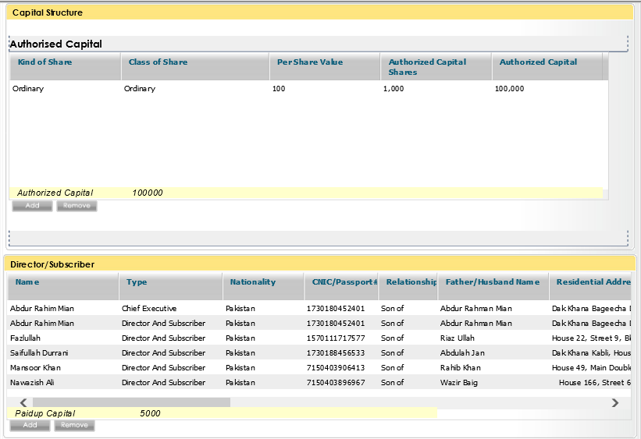
Application: Capital Structure & Director/Subscriber’s Data
(Continued)
Enter the required data.

Slide 8
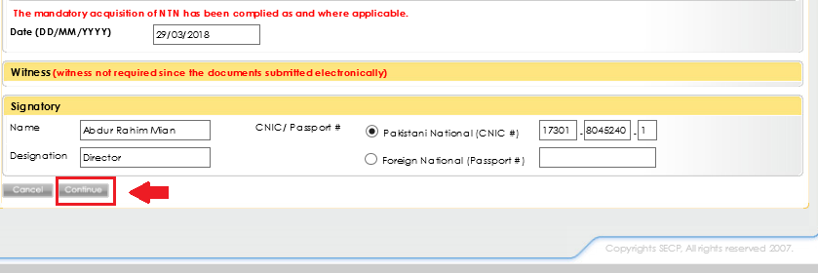
Application: Date & Signatory Details
(Continued)
Click “Continue” after completing the application form.

Slide 9
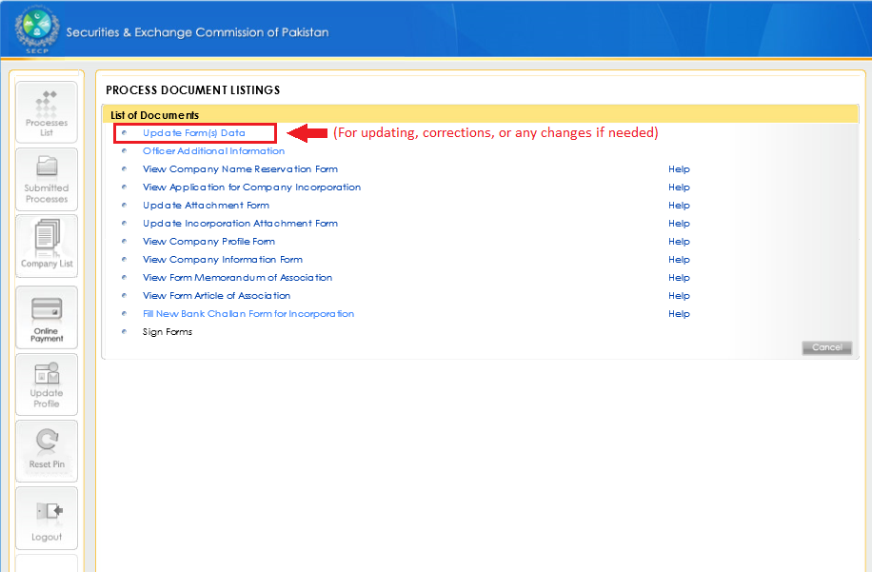
Update the application form if needed
Click “Update the Form(s) Data” to update the form if needed.

Slide 10
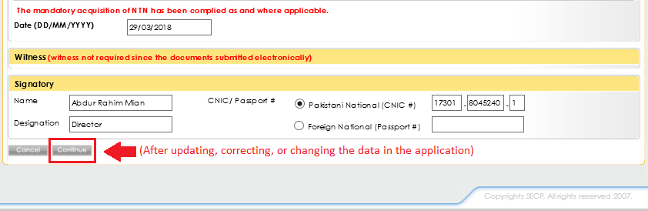
Save the updated Application Form
Click “Continue” after updating the application form.

Slide 11
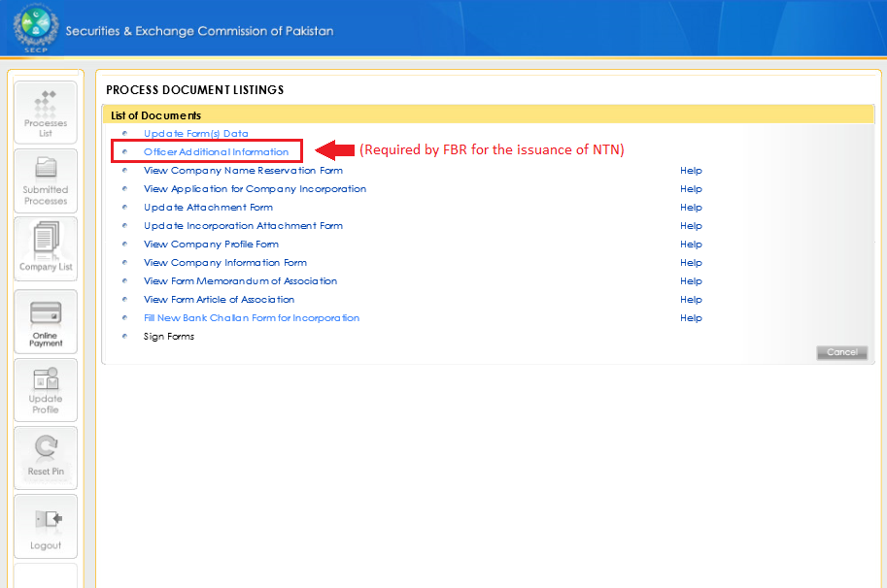
Officer Additional Information
Click “Officer Additional Information” to enter officers information required by the FBR.

Slide 12
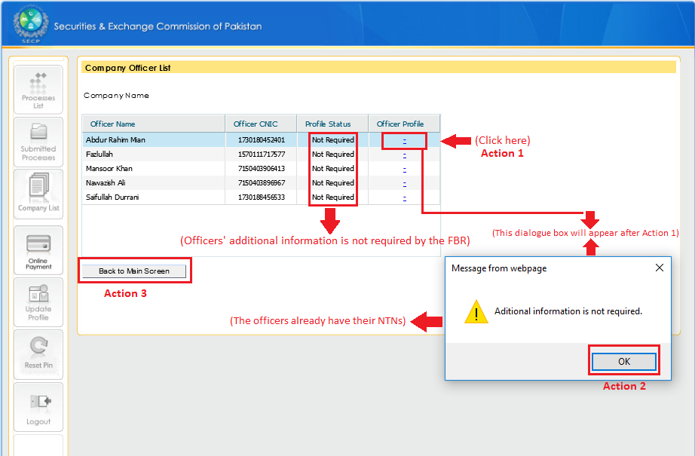
If Company Officers have NTNs already
Perform “Action 1”, then click “OK” (Action 2), and then click “Back to Main Screen” (Action 3) to go back to the Main Screen .

Slide 13
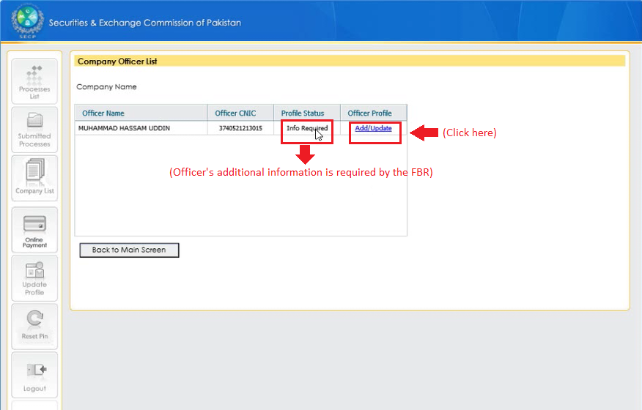
If Company Officers do not have NTNs
Click “Add/Update” to enter the Officers additional information required by the FBR.

Slide 14
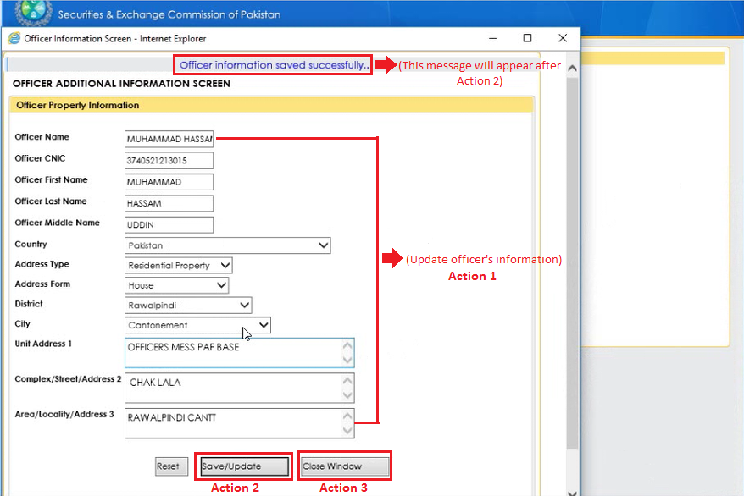
Officer Additional Information
Enter officer additional information (Action 1), click “Save/Update” (Action 2) to save it, and click “Close Window” (Action 3) to close the window.

Slide 15
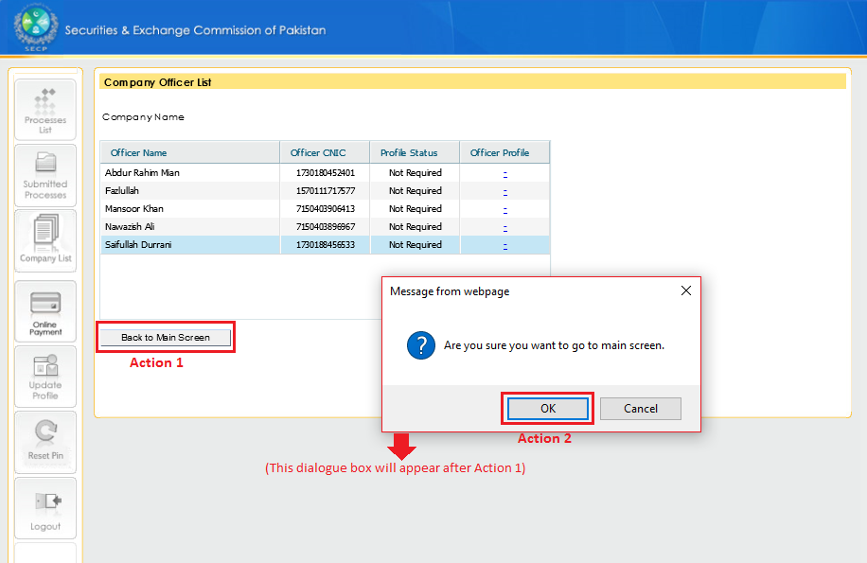
Going back to the Main Screen
Click “Back to Main Screen” (Action 1), then click “OK” (Action 2) to go back to the Main Screen.

Slide 16
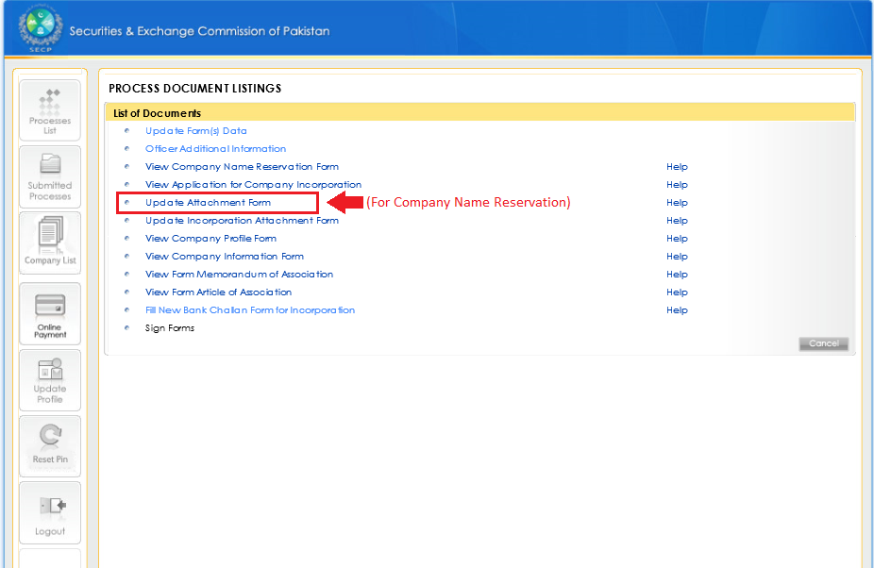
Attachment for Company Name Reservation
Click “Update Attachment Form” to attach the required documents for Company Name Reservation.

Slide 17
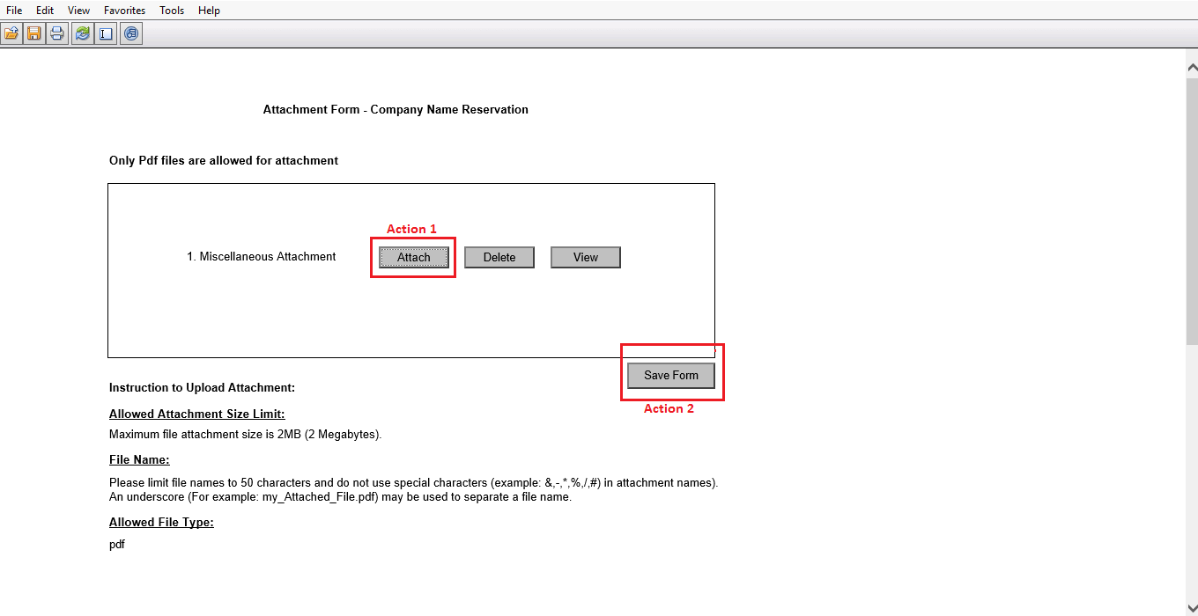
Attachment for Company Name Reservation
(Continued)
Click “Attach” to attach documents supporting the Company Name Reservation Application.
Click “Save Form” to save the attachment.

Slide 18
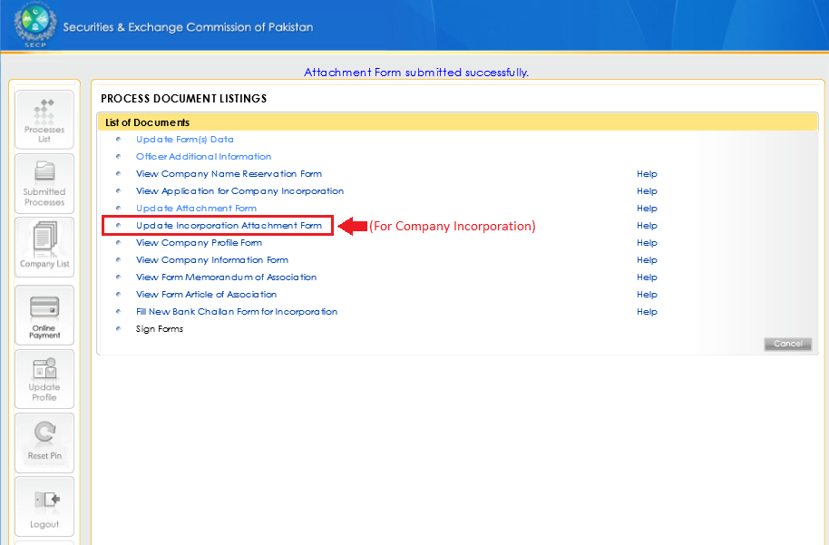
Attachment for Company Incorporation
Click “Update Incorporation Attachment Form” to attach the required documents for Company Incorporation.

Slide 19
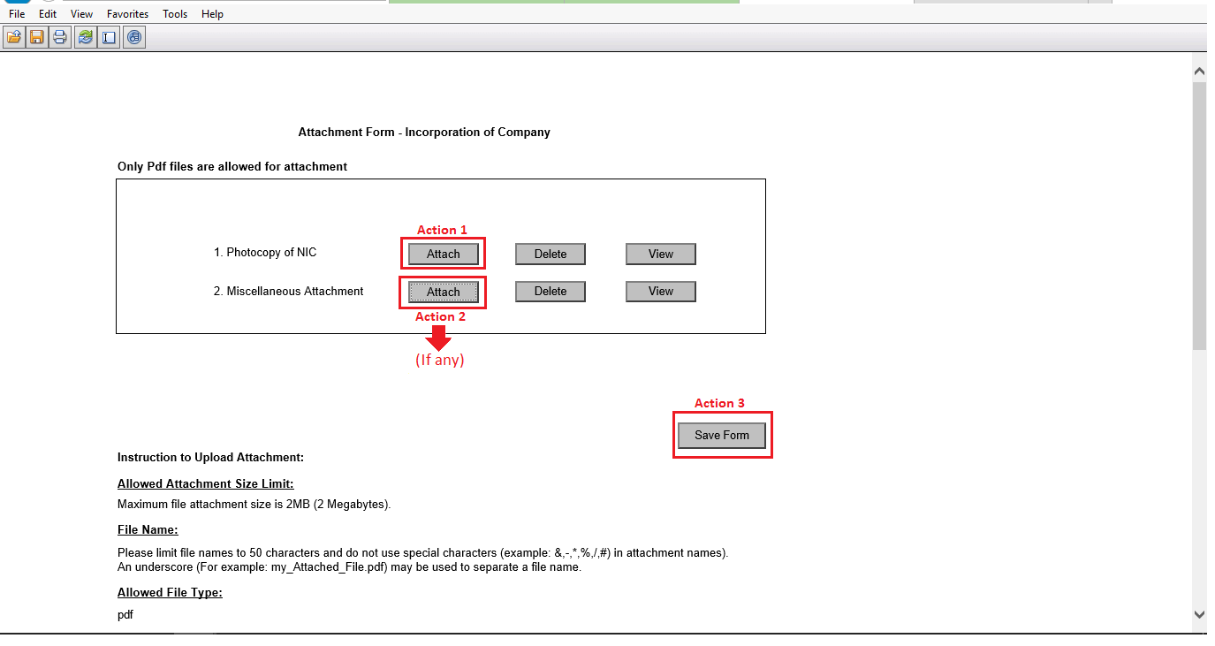
Attachment for Company Incorporation
(Continued)
Click “Attach” (Action 1) to attach CNICs of all the Directors/Subscribers, Representatives, CEO, Nominee etc.
Click “Attach” (Action 2) to attach other supporting documents if required.
Click “Save Form” to save the attachments.

Slide 20
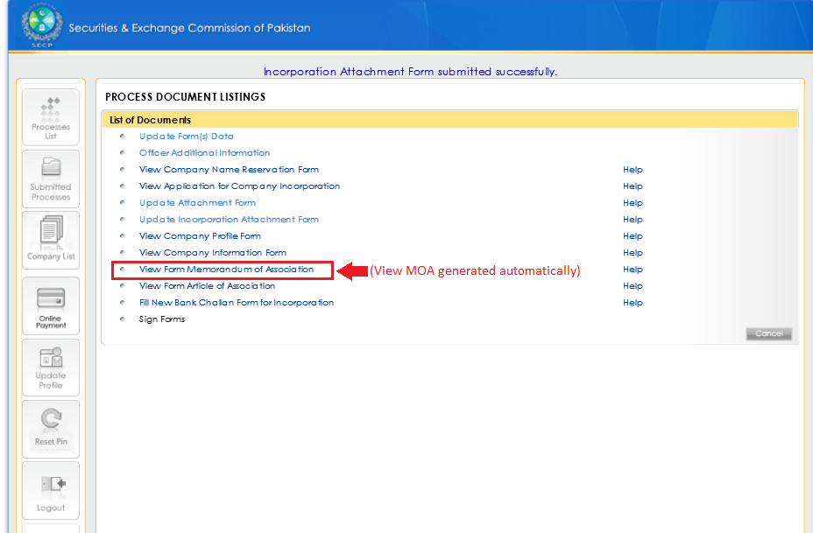
View MOA generated automatically
Click “View Form Memorandum of Association” to view MOA generated automatically.

Slide 21
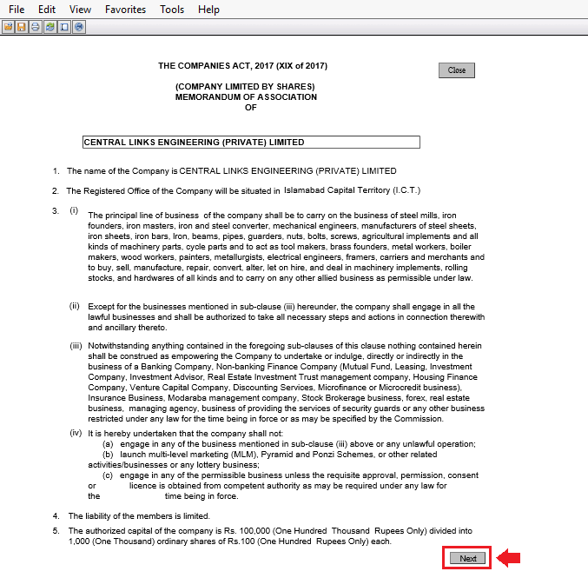
View MOA generated automatically
(Continued)
Click “Next” to view Subscribers Page of MOA.

Slide 22
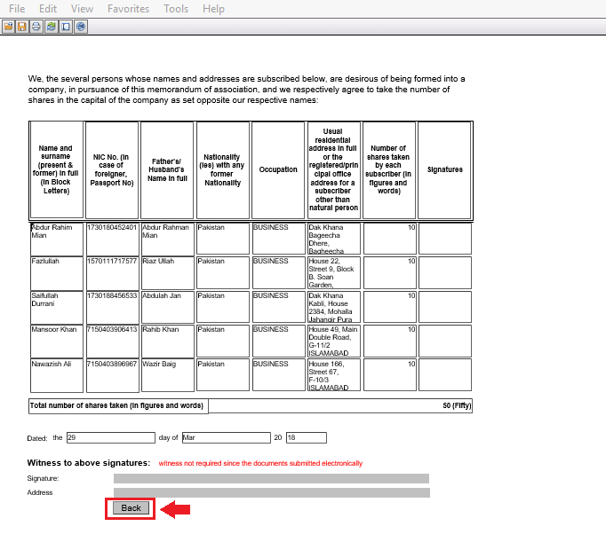
View MOA generated automatically
(Continued)
Click “Back” to go back to the main page of MOA.

Slide 23
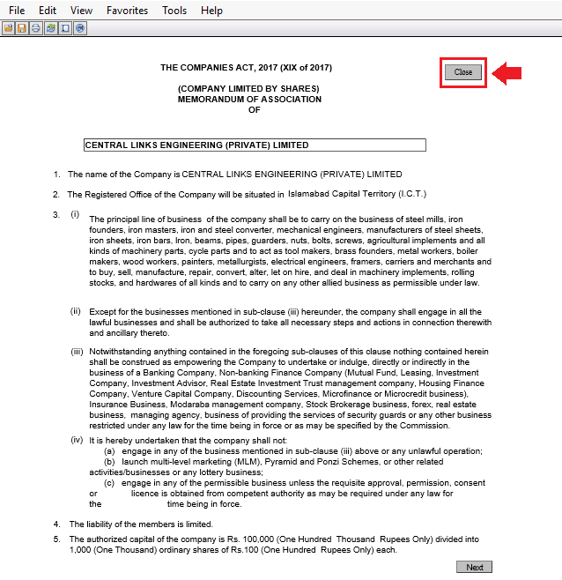
View MOA generated automatically
(Continued)
Click “Close” to go back to the Main Screen.

Slide 24
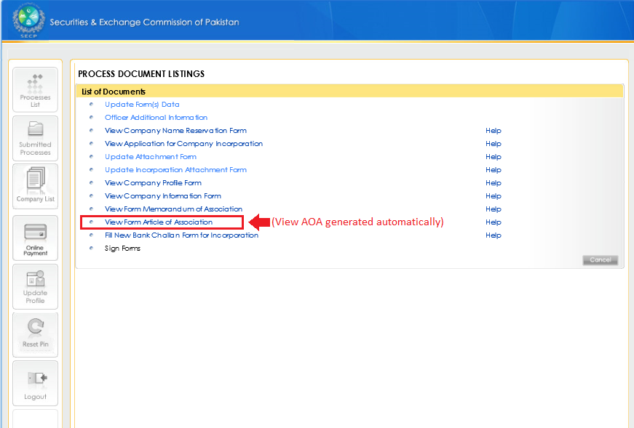
View AOA generated automatically
Click “View Form Article of Association” to view AOA generated automatically.

Slide 25
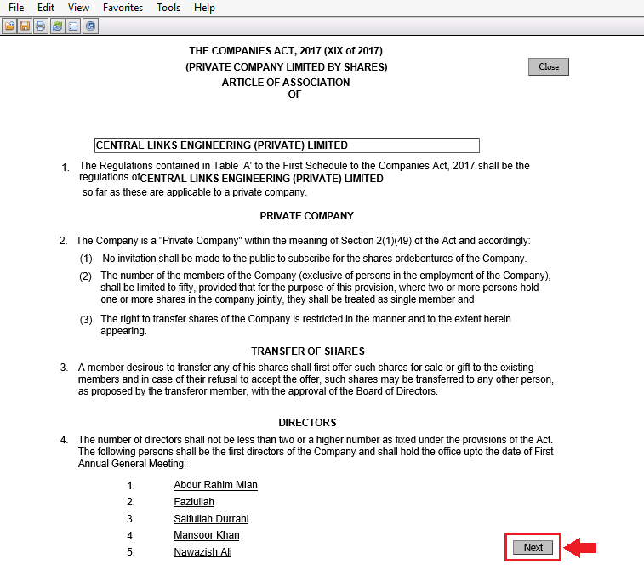
View AOA generated automatically
(Continued)
Click “Next” to view Subscribers Page of AOA.

Slide 26
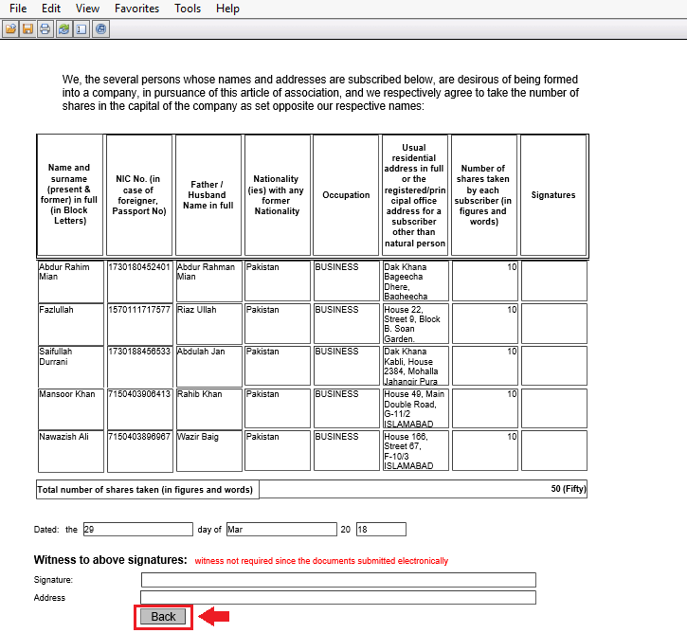
View AOA generated automatically
(Continued)
Click “Back” to go back to the main page of AOA.

Slide 27
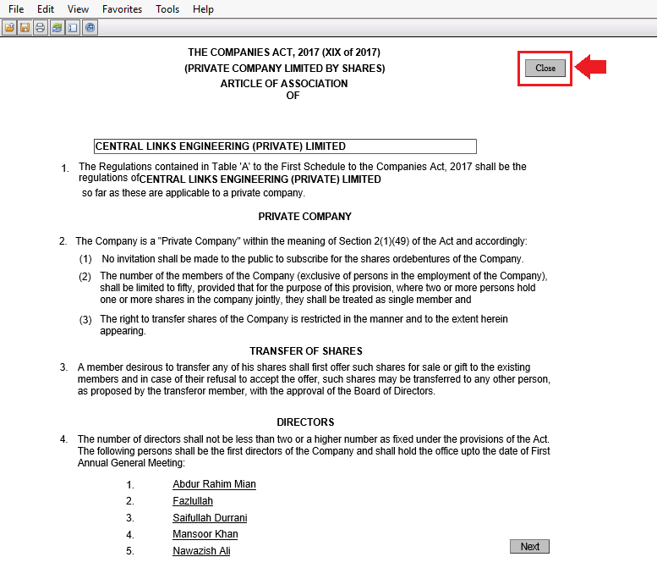
View AOA generated automatically
(Continued)
Click “Close” to go back to the Main Screen.

Slide 28
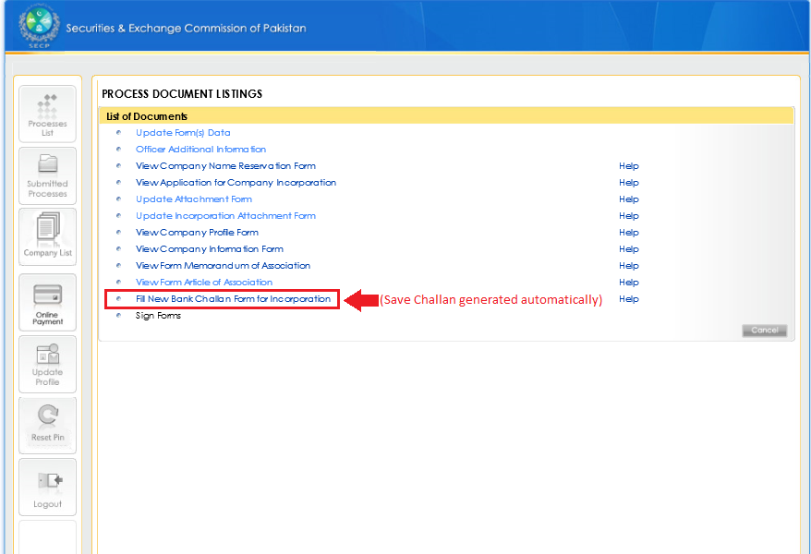
Open Bank Challan generated automatically
Click “Fill New Bank Challan Form for Incorporation” to open the Bank Challan generated automatically.

Slide 29
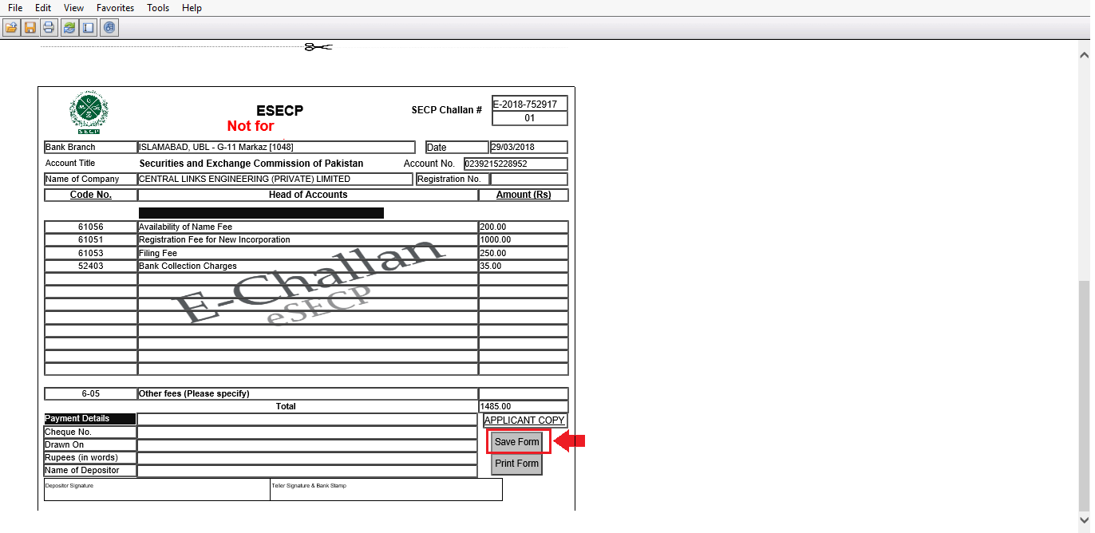
Save Bank Challan generated Automatically
Scroll down the page and click “Save Form” to save the Bank Challan generated automatically.

Slide 30
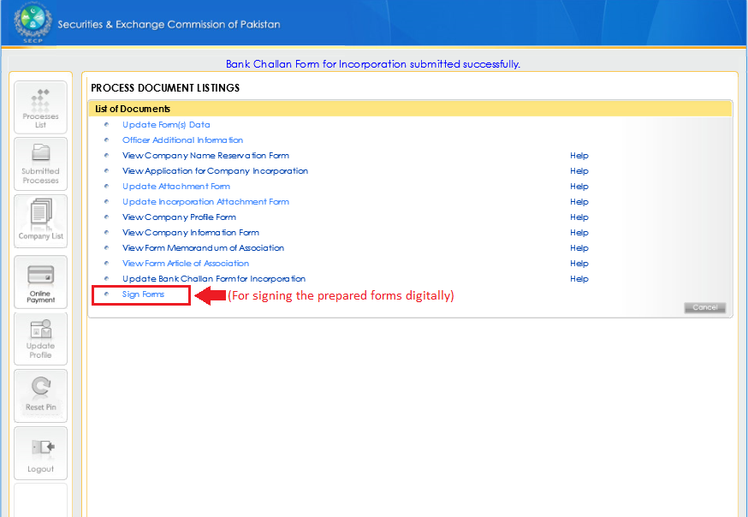
Sign Prepared Forms digitally
Click “Sign Forms” to sign the prepared forms digitally by entering PIN Codes.

Slide 31
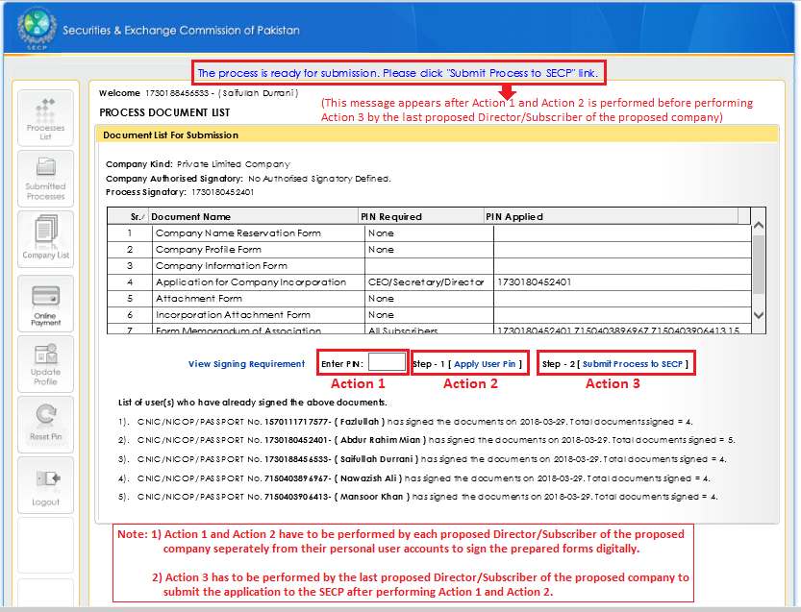
Enter User PINs, Apply User PINs, and Submit Process to SECP
Enter User PINs (Action 1), apply User PINs (Action 2) of Directors/Subscribers separately from their personal User Accounts and submit process to SECP (Action 3) from the last Director/Subscriber’s User Account.

Slide 32
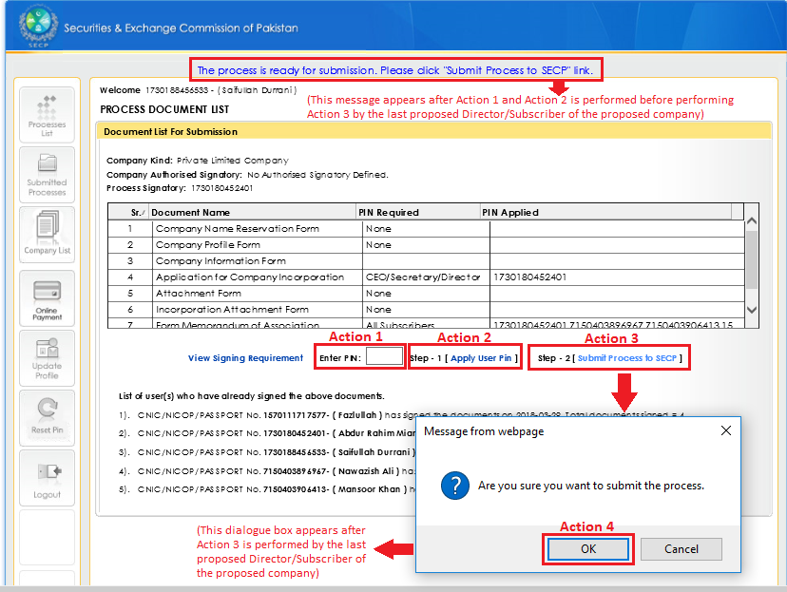
Enter User PINs, Apply User PINs, and Submit Process to SECP
(Continued)
Click “OK” (Action 4) after Action 3 has been performed from the last Director/Subscriber’s User Account.

Slide 33
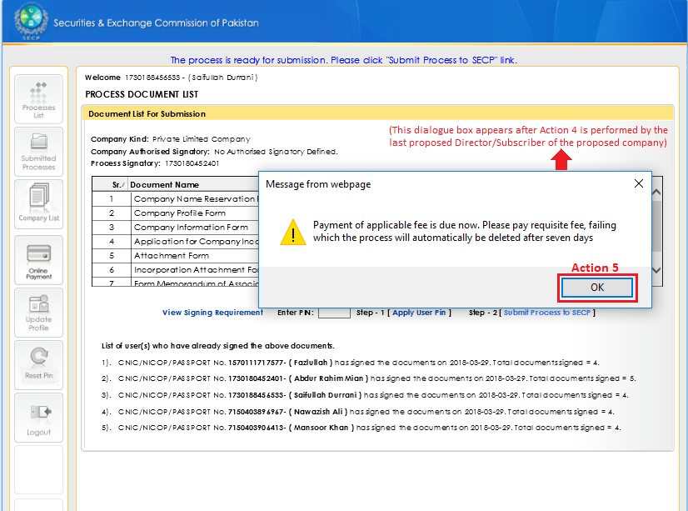
Due applicable fee payment intimation
Click “OK” (Action 5) after Action 4 has been performed from the last Director/Subscriber’s User Account.

Slide 34
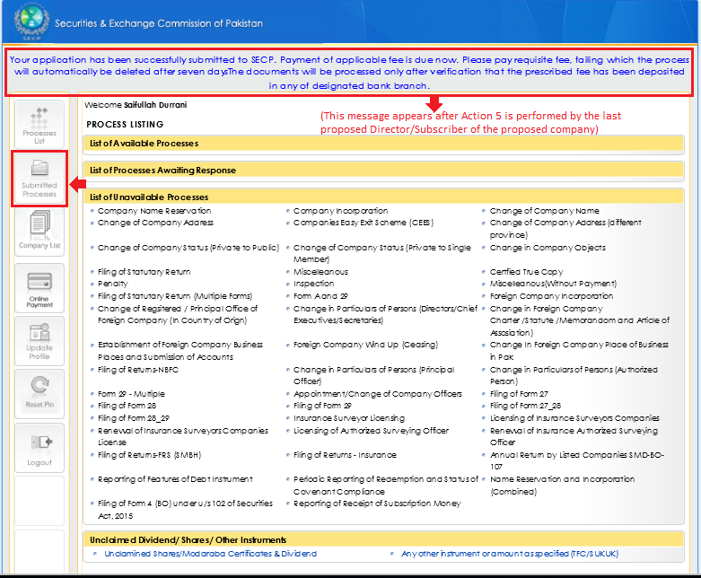
Taking printout of the Bank Challan saved
Click “Submitted Processes” to go to the Submitted Processes Menu.

Slide 35
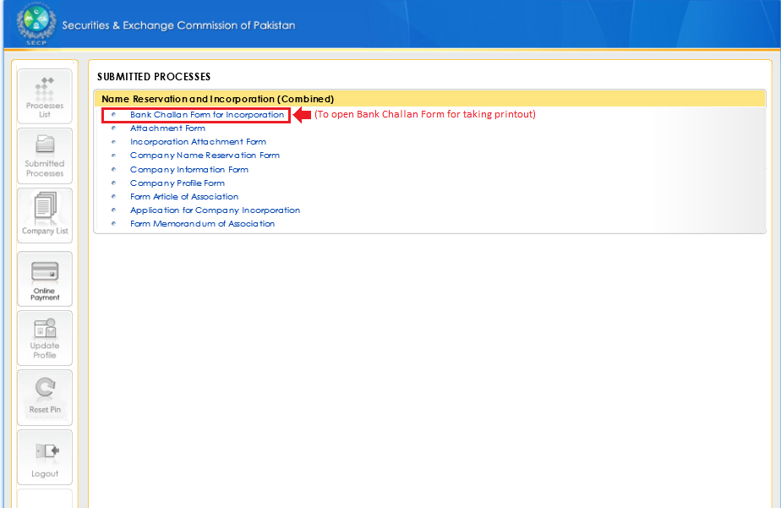
Taking printout of the Bank Challan saved
(Continued)
Click “Bank Challan Form for Incorporation” to open the Bank Challan saved.

Slide 36
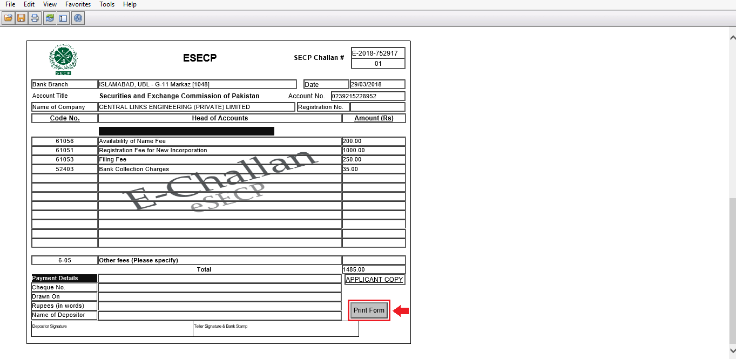
Taking printout of the Bank Challan saved
(Continued)
Click “Print Form” to open print preview window.

Slide 37
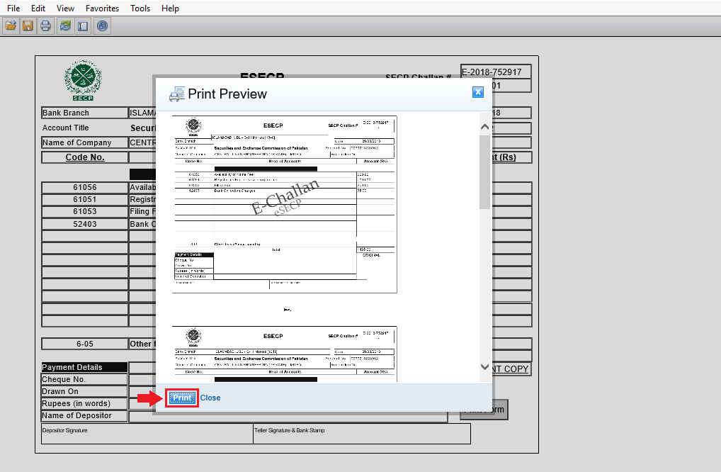
Taking printout of the Bank Challan saved
(Continued)
Click “Print” to open the printer selection window.

Slide 38
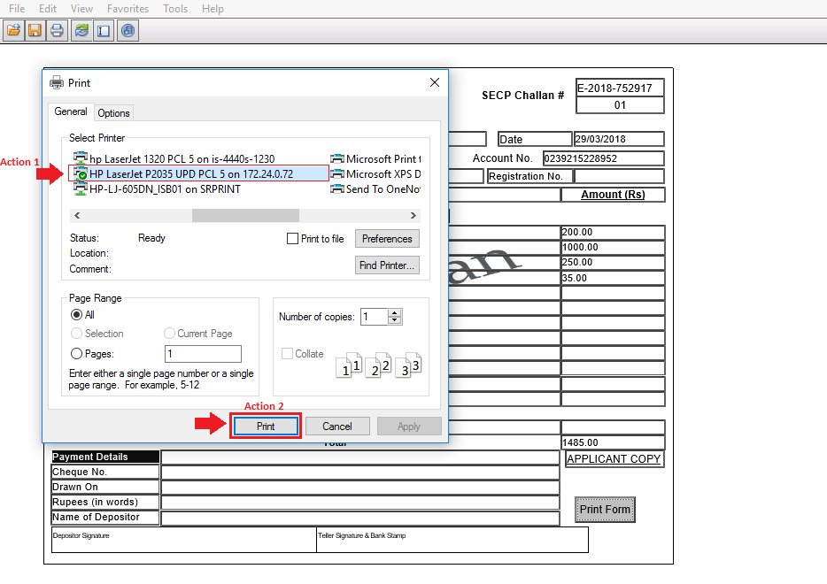
Taking printout of the Bank Challan saved
(Continued)
Select the desired printer (Action 1) and click “Print” (Action 2) to take printout of the Bank Challan saved.

Slide 39
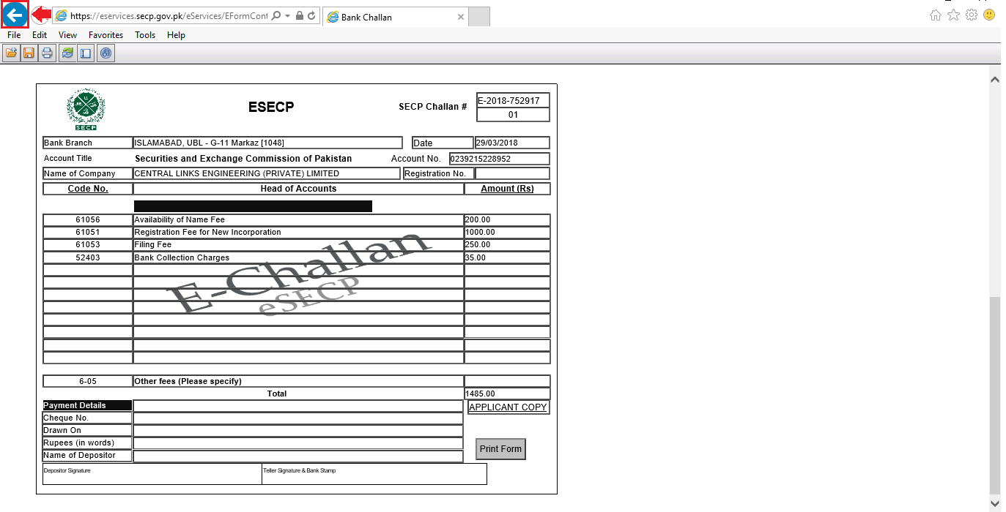
Going back to the Main Screen
Click “Back Tab Icon” located on the top left corner of the page to go back to the Main Screen.

Slide 40
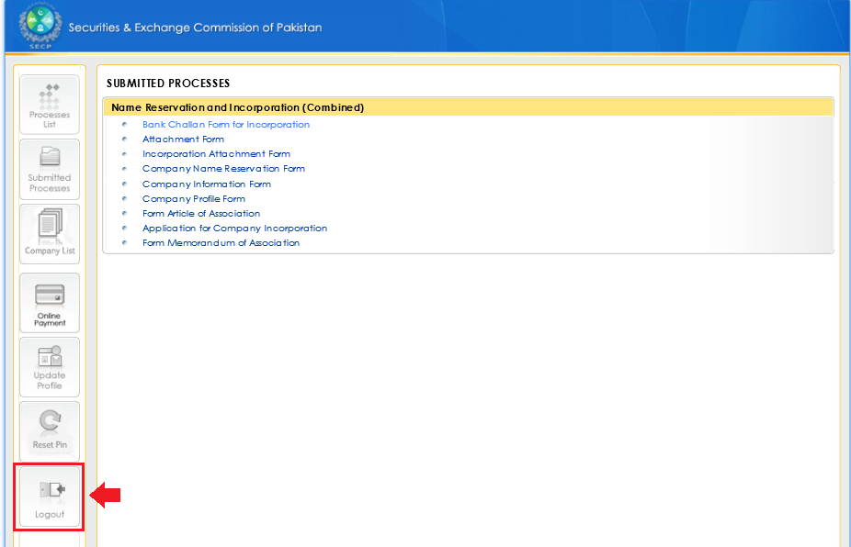
Logout of User Account
Click “Logout” to logout of the User Account.

Slide 41
Completion of Incorporation and NTN Registration Process
On successful completion of the Process;
You will receive an e-mail form SECP that your company has been incorporated followed by incorporation certificate by post.
An e-mail form FBR at company and director’s e-mail containing Login ID, Password and PIN.
Open FBR website e-Services Online verification Portal Online NTN/STRN Inquiry Enter Company Registration No. Or CNIC and NTN details will appear on screen
Open FBR website Open Iris (https://iris.fbr.gov.pk/infosys/public/txplogin.xhtml)
Login using User ID and Password received through e-mail submit Form appearing in Drafts Tab order u/s 181 of ITO will appear in Completed Tasks tab

Slide 42
SIGNIFICANT FILING AND COMPLIANCE REQUIREMENTS UNDER THE COMPANIES ACT, 2017
Notes:
42

Slide 43
CATEGORIES:
POST INCORPORATION REQUIREMENTS (to be complied with within 90 days)
ANNUAL REQUIREMENTS
QUARTERLY REQUIREMENTS
EVENT BASED REQUIREMENTS

Slide 44
POST INCORPORATION FILLINGS AND COMPLINACE REQUIREMENTS (TO BE COMPLIED WITH WITHIN 90 DAYS)

Slide 45
Establishment of registered office:
Applicable to:
Companies incorporated with correspondence Address.
Section: Section 21
Time frame: Within 30 days of incorporation
Return to be filed with registrar : Form 21
Continued……..

Slide 46
Payment of subscription money
Applicable to:
All companies having share capital
Section: Section 17
Time Frame:
Payment to be made within 30 days of incorporation.
Receipt to be reported within 45 days from incorporation
Return to be filed with registrar:
Annexure VII of the Companies (Incorporation) Regulations, 2017, along with certificate by a practicing CA or CMA.
Continued……..

Slide 47
Appointment of Company Secretary
Applicable to: All public companies
Section: Section 194, Section 197
Return to be filed with registrar:
Form 29 within 15 days from appointment.

Slide 48
Appointment of First Auditor
Applicable to: All companies except private companies having paid up capital not exceeding Rs. 1 million.
Section: Section 246
Time Frame: Within 90 days of incorporation
Return to be filed with registrar:
Form 29 within 14 days of appointment along with consent of the auditor

Slide 49
Qualification of Auditor (Section 247)
In the case of a public company or a private company which is subsidiary of a public company or a private company having paid up capital => Rs.3 M
A chartered accountant having valid certificate of practice from the Institute of Chartered Accountants of Pakistan or a firm of chartered accountants;
and
A private company having paid up capital < Rs. 3 M
A chartered accountant or cost and management accountant having valid certificate of practice from the respective institute or a firm of chartered accountants or cost and management accountants, having such criteria as may be specified.

Slide 50
Appointment of Legal Advisor
Applicable to: All Companies having share capital of more than Rs 7.5 million, companies limited by guarantee and Associations u/s 42
Section: Section 2(b) of Companies (Appointment of Legal Advisers) Act, 1974, Section 197 of the Act
Return to be filed with registrar: Form 29 within 15 days of appointment

Slide 51
ANNUAL REQUIREMENTS

Slide 52
Holding of Annual General Meeting (AGM)
  Applicable to: All companies other than SMC
Section: Section 132
Time Frame: First AGM within 16 months from incorporation and thereafter once in every calendar year within 120 days from close of financial year.
In the case of a listed company, the Commission, and, in any other case, the registrar, may for any special reason extend the time within which any annual general meeting, shall be held by a period not exceeding thirty (30) days.

Slide 53
Filing of Annual Return
Section: Section 130
Applicable to: All Companies with following exceptions:
No filling required in case of SMC or a private company having paid up capital <= Rs. 3 M if there is no change of particulars in the last annual return filed with the registrar.
Other companies where there is no change of particulars in the last annual return filed with the registrar are required to file a NO CHANGE RETURN.
Continued……….

Slide 54
Filing of Annual Return
Time Frame:
Within 30 days of holding of AGM and if no AGM held/ concluded, within 30 days of calendar year end.
Up to 15 Days extension may be allowed by Registrar to a listed company.
Return to be filed with registrar:
Form A to be filed by companies having share capital
Form B to be filed by companies not having share capital
Circular No. 29 of 2017 dated November 22, 2017 for no change of particulars.

Slide 55
Filing of Financial statements
Applicable to
Unaudited Financial Statements:
Private companies [not being a subsidiary of a public company] having paid up capital not exceeding Rs.1 million.
Audited Financial Statements:
Listed companies
Other Companies excluding private companies having paid up capital not exceeding Rs. 10 million.
Section: Section 223 (7), Sections 233 & 234

Slide 56
Filing of Financial statements
Time Frame:
Audited Financial Statements:
With the Commission: By listed companies at least 21 days before the AGM (3 copies by post and 1 copy electronically via email address: financial.statements@secp.gov.pk
With the Registrar: Within 30 days of AGM by listed companies and within 15 days by other companies.
Unaudited Financial Statements:
Within 30 days of holding of AGM.
In the case of a listed company the Commission, and in any other case the registrar, may, for any special reason, extend the period for a term not exceeding 30 (thirty) days.

Slide 57
Filing of Beneficial ownership Return
Applicable to: All companies
Section: Section 452 (4)
Time Frame: To be filed along with annual return
Return to be filled with registrar:
Annexure-II notified vide SRO 446 (1)/2017 dated 21-06-2017

Slide 58
Appointment of Subsequent Auditors
Applicable to: All companies
Section: Section 246(2), 223(5) and Section 197
Time Frame: At AGM / within 30 days of occurrence of casual vacancy
Return to be filled with registrar:
Form 29 within 15 days of appointment along with consent of auditor(s)

Slide 59
QUARTERLY REQUIREMENTS

Slide 60
Filing of quarterly financial statements
Applicable to: Listed companies only
Section: Section 237
Time Frame:
With the Commission through e-mail:
Within 30 days of the close of 1st and 3rd quarters
Within 60 days of the close of its 2nd quarter
The Commission may on application may extend the period of filing in case of accounts of 1st quarter for a period not exceeding 30 days, if the company has been allowed extension in terms of Section 223.
With the registrar: E-filling within the same timelines.

Slide 61
EVENT BASED REQUIREMENTS

Slide 62
Commencement of business
Applicable to: All public companies.
A public company shall not start its operations or exercise any borrowing powers unless requirements of Section 19 have been met and documents have been accepted and registered.
Section: Section 19
Return to be filed with registrar:
Declaration on From 23 along with statement in lieu of prospectus by pubic unlisted companies
Declaration on Form 22 along with prospectus and other returns/ documents by listed companies

Slide 63
Change in registered office address
Applicable to: All companies changing their registered office address
Approval of general meeting through special resolution:
For change of registered office from one city to another within same province OR a city to another in any part of Pakistan not forming part of a Province
Petition under Section 32 to Registrar required after passing of special resolution:
From one province to another province or ICT or vice versa; and
From one province or ICT to a part of Pakistan not forming part of a province or vice versa
Section: Section 21, Section 32 and Section 150
Return to be filed with registrar:
Form 21 within 15 days from date of change
Form 26 within 15 days of passing of special resolution

Slide 64
Alteration in the principal line of business
Applicable to: Companies changing their principle line
Section: Section 32
Return to be filed with registrar:
Form 26 along-with amended copy of memorandum of association within 30 days of passing of Special Resolution
No Approval Required for change in principle line of business

Slide 65
Election of Directors
Applicable to: All companies except SMC
Section: Sections 157, 161 and 162
Time Frame: First election of directors in first AGM and thereafter every 03 years.
Return to be filed with registrar:
Form 28; and
Form 29
within 15 days of election

Slide 66
Appointment of director, chief executive
Applicable to: All companies for every change in directorship or CEO
Appointment of CEO: Within fourteen days from the date of election of directors or the office of the chief executive falling vacant;
Casual Vacancy of Directors: At the earliest but not later than ninety days from the date, the vacancy occurred.
Section: Section 155,167, 187 and 197
Return to be filed with registrar:
Form 28; and
Form 29
within 15 days of appointment

Slide 67
Statutory meeting
Applicable to: All public companies having share capital
Section: Section 131
Time Frame: Within 180 days from date at which company is entitled to commence business or within 09 months from incorporation whichever earlier
Note:- If first AGM is decided to be held earlier, no statutory meeting shall be required.
Return to be filed with registrar:
Certified copy of statutory report on Form 25, along with report of auditors at least 21 days before meeting.

Slide 68
Increase in authorized capital
Applicable to: All companies having share capital
Section: Sections 85
Return to be filed with registrar:
Form 7; and
Form 26
within 15 days of passing of special resolution

Slide 69
Share transfer return
Applicable to: Private Companies or public unlisted companies
Section: Section 74/76 read with Rule 12 B of the Companies(General Provisions and Forms) Rules,1985
Return to be filed with registrar:
Form 3A within 15 days from the registration of transfer

Slide 70
REGISTRATION OF MORTGAGES, CHARGES
Registration/ modification of mortgage or charge or pledge
Section: Section 100, 106 & 448
Time Frame: Within 30 days of creation / modification
Return to be filed with registrar:
Form 10: Particulars of Mortgages, Charges etc.
Form 16: Particulars of modification of Mortgages, Charges etc.
Along with verified copy of charge creating/ modification instruments & Affidavit (for correctness of submitted documents)

Slide 71
REGISTRATION OF MORTGAGES, CHARGES
Satisfaction of mortgage or charge or pledge
Section: Section 109, 448
Time Frame: Within 30 days of satisfaction
Return to be filed with registrar:
Form 17: Memorandum of complete satisfaction of Mortgages, Charges etc.
Along with along with memorandum of satisfaction of mortgage or charge and NOC on behalf of mortgage/ charge holder.

Slide 72
Further allotment of shares
Applicable to: All companies
Section: Sections 70 and 83 read with Rule 12 C of the Companies(General Provisions and Forms) Rules,1985
Return to be filed with registrar:
Form 3B simultaneously with dispatch to members(at least 15 days before the last date of acceptance of offer)
Form 3 within 45 days from allotment of shares along with auditor report or where it is not mandatory to appoint an auditor, from a practicing CA or CMA.

Slide 73
Filling of Special Resolutions
Applicable to: All companies
Section: Section 150
Return to be filed with registrar:
Form 26 within fifteen (15) days of passing of special resolution

Slide 74
THANK YOU

